Slide 1
Android Training
Saving Data
http://developer.android.com/training/index.html
师文轩，13920561100，shiwenxuan2003@hotmail.com

Slide 2
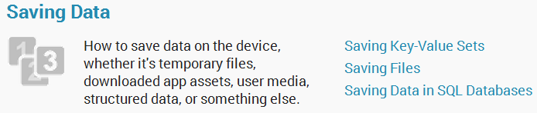
Saving Data

Slide 3
Intro
Most Android apps need to save data, even if only to save information about the app state during onPause() so the user's progress is not lost.
This class introduces you to the principal data storage options in Android

Slide 4
Lessons
Saving Key-Value Sets
Saving Files
Saving Data in SQL Databases

Slide 5
Saving Key-Value Sets
If you have a relatively small collection of key-values that you'd like to save, you should use the SharedPreferences APIs.
This class shows you how to use the SharedPreferences APIs to store and retrieve simple values.

Slide 6
Get a Handle to a SharedPreferences
  You can create a new shared preference file or access an existing one by calling one of two methods:
    getSharedPreferences()
    getPreferences()

Slide 7

  For example,
    When naming your shared preference files, you should use a name that's uniquely identifiable to your app, such as "com.example.myapp.PREFERENCE_FILE_KEY"

Slide 8
    Alternatively, if you need just one shared preference file for your activity, you can use the getPreferences() method:
    Caution: If you create a shared preferences file with MODE_WORLD_READABLE or MODE_WORLD_WRITEABLE, then any other apps that know the file identifier can access your data.

Slide 9
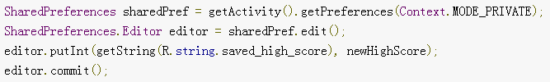
Write to Shared Preferences
  To write to a shared preferences file, create a SharedPreferences.Editor by calling edit() on yourSharedPreferences.
  For example:

Slide 10

Read from Shared Preferences
  To retrieve values from a shared preferences file, call methods such as getInt() and getString()
  For example:

Slide 11
Saving Files
Android uses a file system that's similar to disk-based file systems on other platforms.
This lesson describes how to work with the Android file system to read and write files with the File APIs.

Slide 12
Choose Internal or External Storage
  Internal storage is best when you want to be sure that neither the user nor other apps can access your files.
  External storage is the best place for files that don't require access restrictions and for files that you want to share with other apps or allow the user to access with a computer.

Slide 13
  Internal storage:
    It's always available.
    Files saved here are accessible by only your app by default.
    When the user uninstalls your app, the system removes all your app's files from internal storage.

Slide 14
  External storage:
    It's not always available, because the user can mount the external storage as USB storage and in some cases remove it from the device.
    It's world-readable, so files saved here may be read outside of your control.
    When the user uninstalls your app, the system removes your app's files from here only if you save them in the directory from getExternalFilesDir().

Slide 15
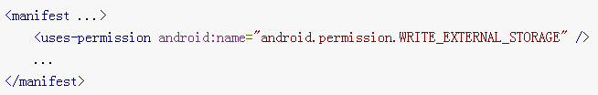
Obtain Permissions for External Storage
  To write to the external storage, you must request the WRITE_EXTERNAL_STORAGE permission in your manifest file:

Slide 16
  You don’t need any permissions to save files on the internal storage. Your application always has permission to read and write files in its internal storage directory.

Slide 17
Save a File on Internal Storage
  When saving a file to internal storage, you can acquire the appropriate directory as a File by calling one of two methods:
    getFilesDir()
    getCacheDir()

Slide 18
  To create a new file in one of these directories, you can use the File() constructor

Slide 19
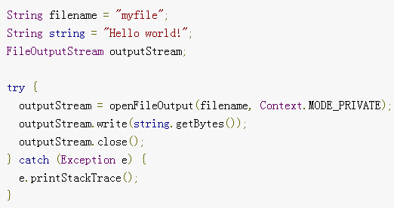
    Alternatively, you can call openFileOutput() to get a FileOutputStream that writes to a file in your internal directory

Slide 20
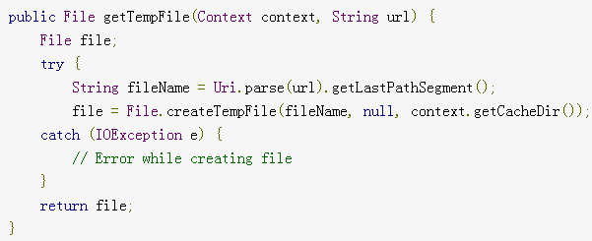
  Or, if you need to cache some files, you should instead use createTempFile().

Slide 21
Save a File on External Storage
  You can query the external storage state by calling getExternalStorageState(). If the returned state is equal to MEDIA_MOUNTED, then you can read and write your files.

Slide 22
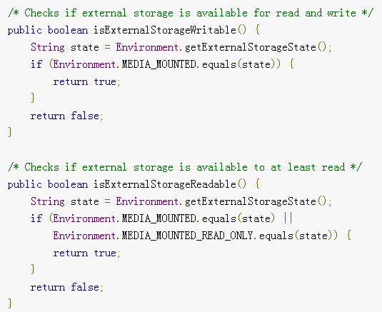

Slide 23
  Although the external storage is modifiable by the user and other apps, there are two categories of files you might save here:
    Public files
    Private files

Slide 24
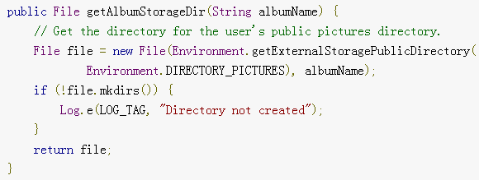
  If you want to save public files on the external storage, use the getExternalStoragePublicDirectory() method to get a File representing the appropriate directory on the external storage.

Slide 25
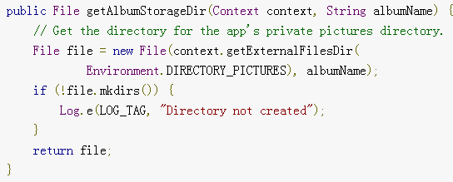
  If you want to save files that are private to your app, you can acquire the appropriate directory by calling getExternalFilesDir() and passing it a name indicating the type of directory you'd like.

Slide 26
Query Free Space
  If you know ahead of time how much data you're saving, you can find out whether sufficient space is available without causing an IOException by calling getFreeSpace() or getTotalSpace().

Slide 27
Delete a File
  Note: When the user uninstalls your app, the Android system deletes the following:
    All files you saved on internal storage
    All files you saved on external storage using getExternalFilesDir().
  However, you should manually delete all cached files created with getCacheDir() on a regular basis and also regularly delete other files you no longer need.

Slide 28
Saving Data in SQL Databases
Saving data to a database is ideal for repeating or structured data, such as contact information.
This class assumes that you are familiar with SQL databases in general and helps you get started with SQLite databases on Android.

Slide 29
Define a Schema and Contract
  One of the main principles of SQL databases is the schema: a formal declaration of how the database is organized.
  One of the main principles of SQL databases is the schema: a formal declaration of how the database is organized.

Slide 30
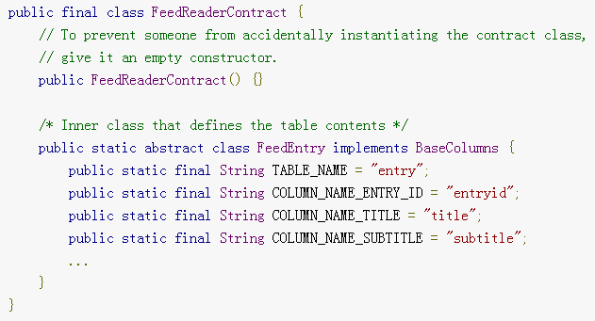
  For example, this snippet defines the table name and column names for a single table:

Slide 31
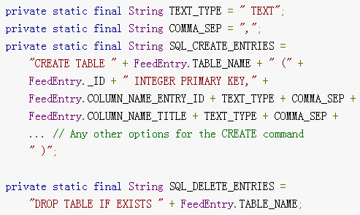
Create a Database Using a SQL Helper
  Here are some typical statements that create and delete a table:

Slide 32
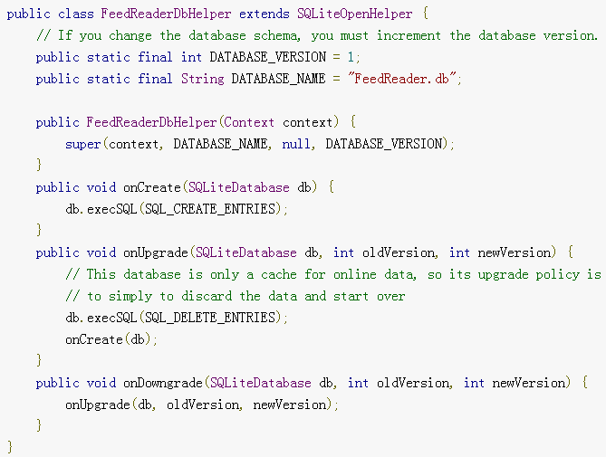
  A useful set of APIs is available in the SQLiteOpenHelper class.

Slide 33
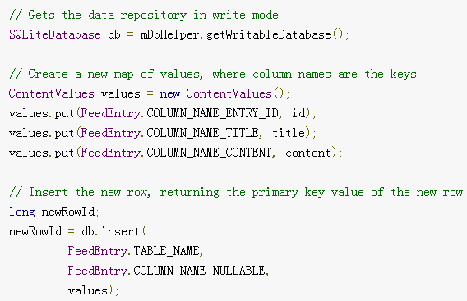
Put Information into a Database
  Insert data into the database by passing a ContentValues object to the insert() method:

Slide 34
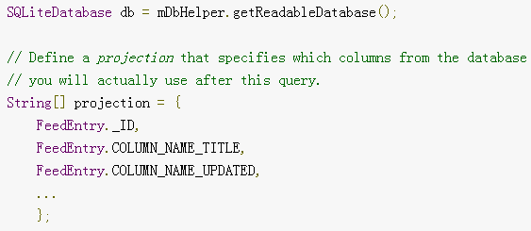
Read Information from a Database
  To read from a database, use the query() method, passing it your selection criteria and desired columns.

Slide 35
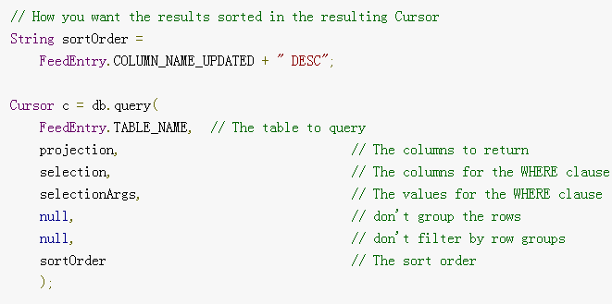

Slide 36

  To look at a row in the cursor, use one of the Cursor move methods, which you must always call before you begin reading values.
  Generally, you should start by calling moveToFirst(), which places the "read position" on the first entry in the results.

Slide 37
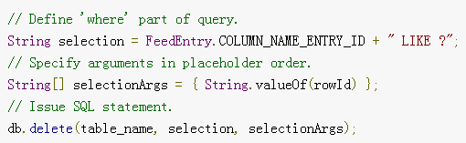
Delete Information from a Database

Slide 38
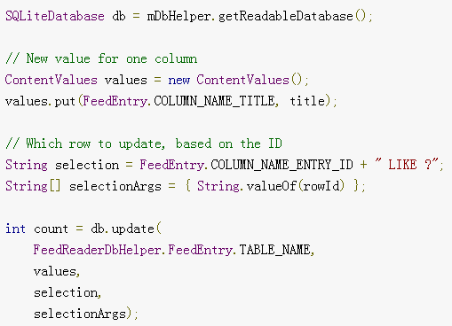
Update a Database

